Slide 1


Lecture 29
Produced by Dr. Worldwide
Welcome to the 305
~
~

Slide 2

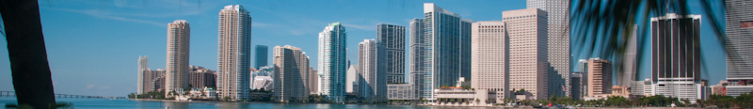
Stochastic Simulation
Simulation is used to “simulate” the operations of various kinds of real-world systems or processes with the aid of a computer
We make assumptions about how a system works
These assumptions constitute a model
Models are used to gain some understanding of how a system behaves
In simple models, we can use analytical (mathematical) methods to obtain exact information on questions of interest
In complex models, use simulation to evaluate the model numerically

Slide 3
Monte Carlo Process
Large proportion of applications of simulations are for probabilistic models
Monte Carlo is a technique for selecting numbers randomly from a probability distribution
Monte Carlo is not a simulation model, but a mathematical process used within a simulation
Monte Carlo simulation can also be thought of as multiple probability simulation
Read Link 1 on course website for more description about Monte Carlo

Slide 4
Random Number Generator
To run a simulation, we may need “observations” from a random process
If we “know” the distribution of these observations, we might be able to generate them artificially
Historically, random numbers have been generated physically
Throwing dice
Dealing cards
Drawing balls from urns
Not until mid 1950’s where electronic random number generators were used
Two kinds of random number generators: physical and numerical
Computer are equipped with numerical random number generators

Slide 5
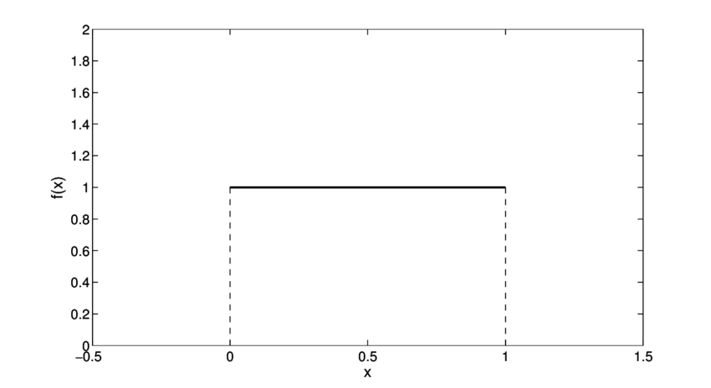
Random Number Generator
Q: Other than my teaching, is anything truly random?
Numerical random number generators are not really random
The most basic type of random numbers that we can artificially generate are from the Uniform[0,1] distribution where numbers between 0 and 1 are equally likely
RAND() function in Excel samples from this distribution
We can generate random numbers from any other
distribution from the RAND() function
Read Link 2 on course website for more description
about RAND()

Slide 6
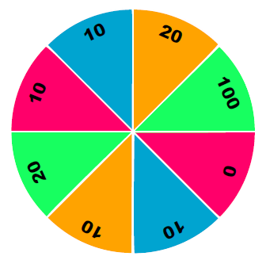
Ex: Spinning a Wheel
Suppose we want to simulate the result of spinning a wheel of fortune
No physical version of the wheel, but can generate random uniform numbers
Q: How can we use RAND() to “spin” the wheel?

Slide 7
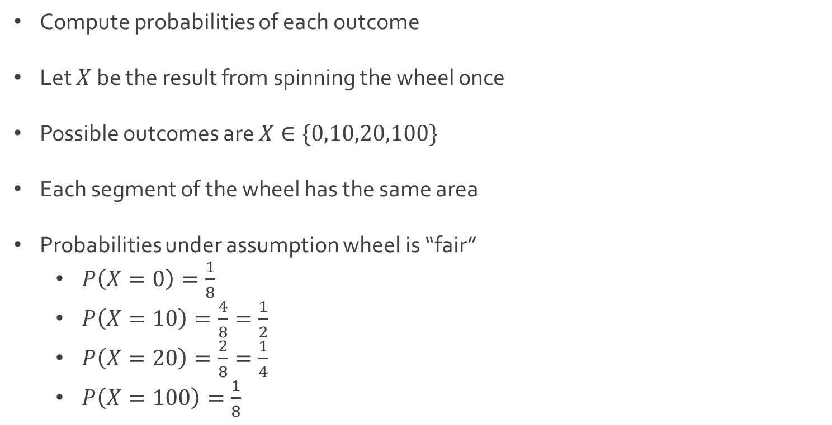
Ex: Spinning a Wheel
Compute probabilities of each outcome
Let $X$ be the result from spinning the wheel once
Possible outcomes are $X∈\{0,10,20,100\}$
Each segment of the wheel has the same area
Probabilities under assumption wheel is “fair”
$P\left(X=0\right)=\frac{1}{8}$
$P\left(X=10\right)=\frac{4}{8}=\frac{1}{2}$
$P\left(X=20\right)=\frac{2}{8}=\frac{1}{4}$
$P\left(X=100\right)=\frac{1}{8}$

Slide 8
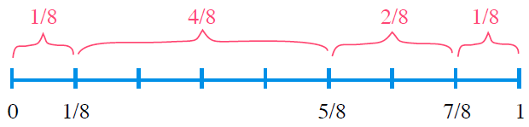
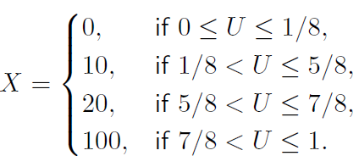
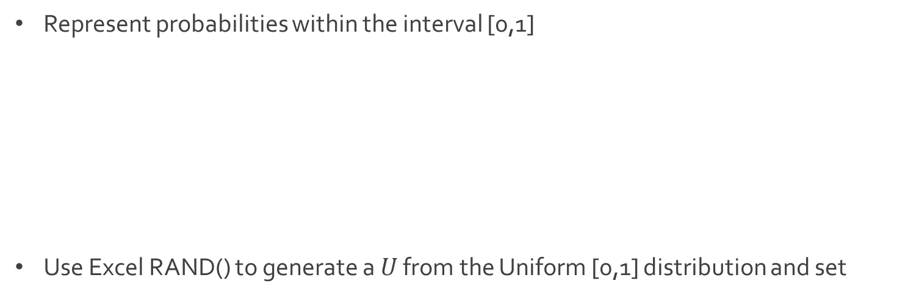
Ex: Spinning a Wheel
Represent probabilities within the interval [0,1]
Use Excel RAND() to generate a $U$ from the Uniform [0,1] distribution and set

Slide 9


Ex: Spinning a Wheel
Download SpinWheel.xlsx from link Sheet 1 on course website
When we use the RAND() function repeatedly, the random numbers generated are independent of each other
We can use Excel to simulate as many spins of the wheel as we want
Random sample located in cells E6:E47
We are simulating 42 spins of this wheel
Compare theoretical mean and standard deviation to sample statistics

Slide 10
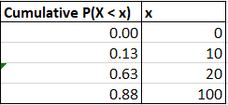

Ex: Spinning a Wheel
To transform, the Uniform[0,1] numbers generated by the function RAND() we can create a look-up table
1st column contains the values of the function h$\left(x\right)=P(X<x)$
2nd column contains the values of $x$
Table contain in array B6:C9
Table saved into variable named CDF_Table

Slide 11
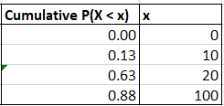
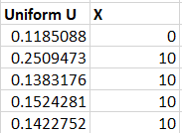

Ex: Spinning a Wheel
The command VLOOKUP(cell, look-up table, 2) will compare the number in the cell to the ranges defined by the first column of the look-up table, and return the value in the second column
Example of function usage
Value $U=0.1185$ is between $0$ and $0.13$ so VLOOKUP returns $0$

Slide 12

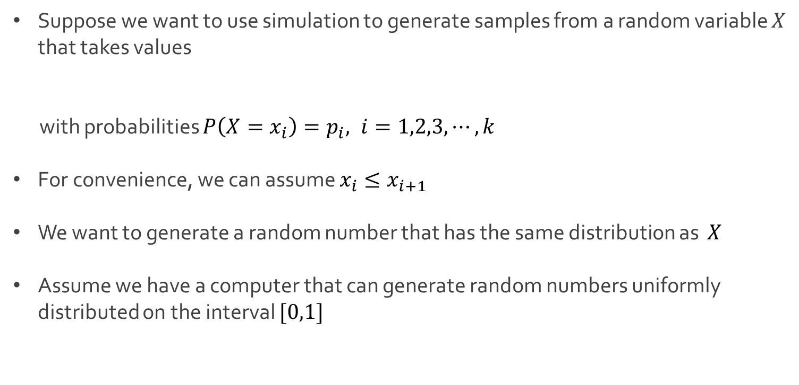
Simulation for Discrete
Suppose we want to use simulation to generate samples from a random variable $X$ that takes values
with probabilities $P\left(X=x_{i}\right)=p_{i}, i=1,2,3,⋯,k$
For convenience, we can assume $x_{i}≤x_{i+1}$
We want to generate a random number that has the same distribution as $X$
Assume we have a computer that can generate random numbers uniformly distributed on the interval $[0,1]$
$$\{x_{1},x_{2},x_{3},⋯,x_{k}\}$$

Slide 13
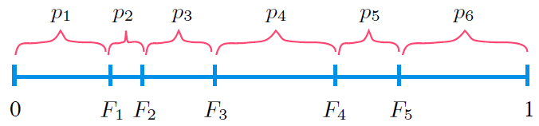

Simulation for Discrete
Step 1: Compute the cumulative probabilities
Note that $F_{0}=0$ and $F_{k}=1$
Step 2: Generate a random number $U∼Uniform[0,1]$
Step 3: Return $X=x_{i}$ if $F_{i−1}<U≤F_{i}$
$$F_{i}=P\left(X≤x_{i}\right)=p_{1}+⋯+p_{i}, i=1,2,3,⋯,k$$

Slide 14
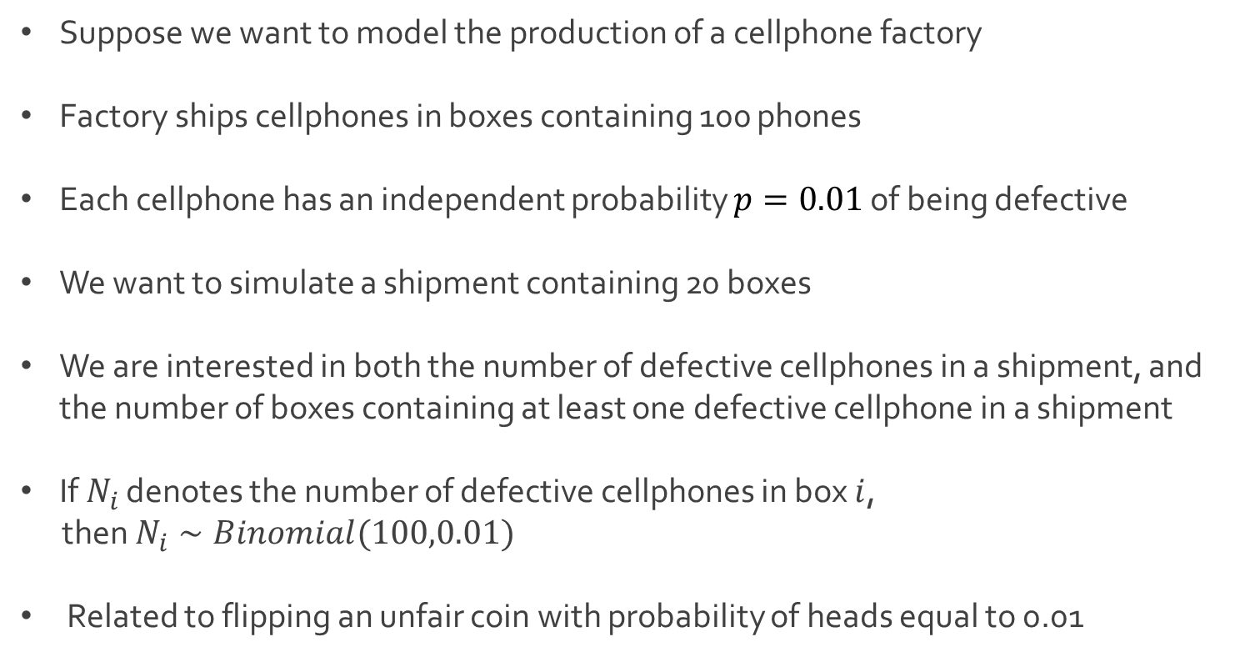
Ex: Cell Phone Production
Suppose we want to model the production of a cellphone factory
Factory ships cellphones in boxes containing 100 phones
Each cellphone has an independent probability $p=0.01$ of being defective
We want to simulate a shipment containing 20 boxes
We are interested in both the number of defective cellphones in a shipment, and the number of boxes containing at least one defective cellphone in a shipment
If $N_{i}$ denotes the number of defective cellphones in box $i$,
then $N_{i}∼Binomial(100,0.01)$
Related to flipping an unfair coin with probability of heads equal to 0.01

Slide 15
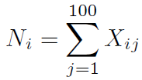
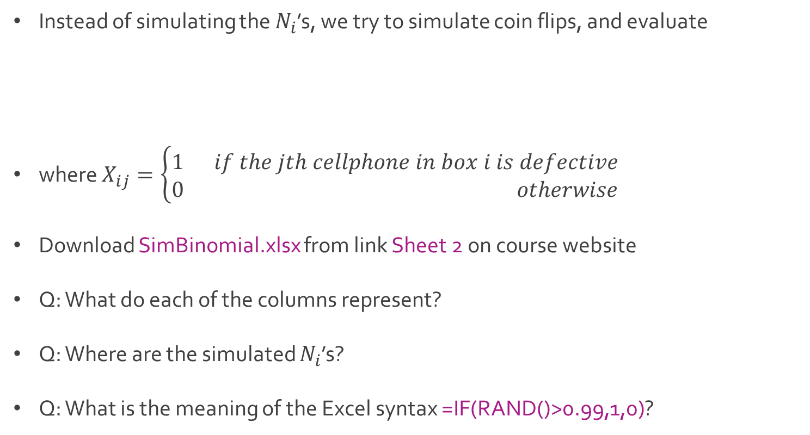
Ex: Cell Phone Production
Instead of simulating the $N_{i}$’s, we try to simulate coin flips, and evaluate
where $X_{ij}=\left\{\begin{aligned}1 if the jth cellphone in box i is defective \\ 0 otherwise\end{aligned}\right.$
Download SimBinomial.xlsx from link Sheet 2 on course website
Q: What do each of the columns represent?
Q: Where are the simulated $N_{i}$’s?
Q: What is the meaning of the Excel syntax =IF(RAND()>0.99,1,0)?

Slide 16




The End
Dale

